Slide 1
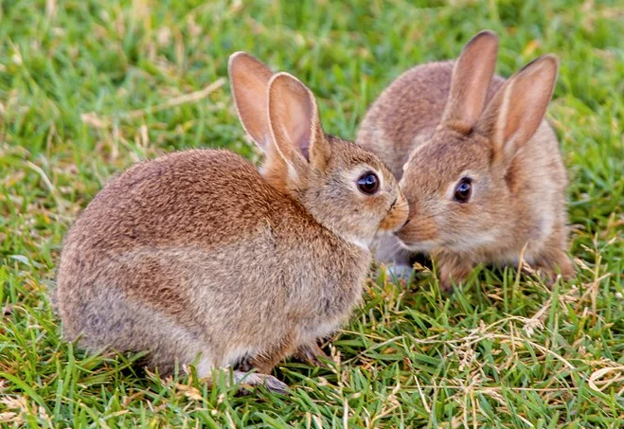
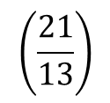
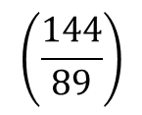
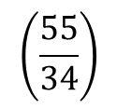
ஃபிபனாச்சி தொடர்- தமிழ்
$$\left(\frac{55}{34}\right)$$
Fibonacci Sequence
$$\left(\frac{144}{89}\right)$$
The sequence where each number is made by adding the previous 2 numbers, where the 1st term F1 & the 2nd term F2 are 1.
$$\left(\frac{21}{13}\right)$$
Fibonacci introduced the sequence. However, the origin has been traced back to ancient India as early as 200 BC, where it has been applied in mathematics and musical patterns.
Then Phi is like the common ratio of geometric sequence.

Slide 2
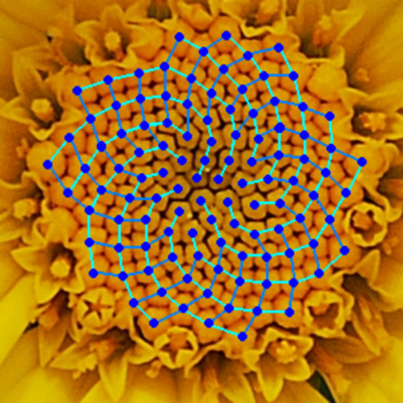
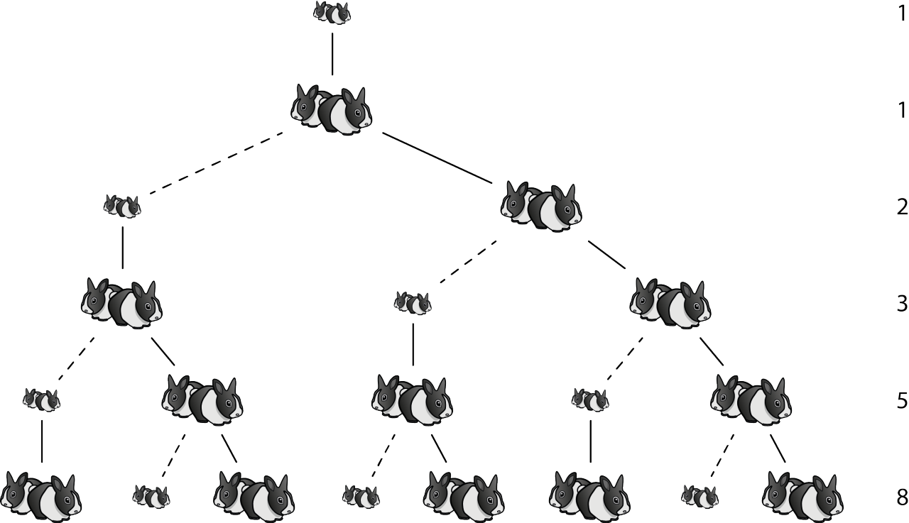
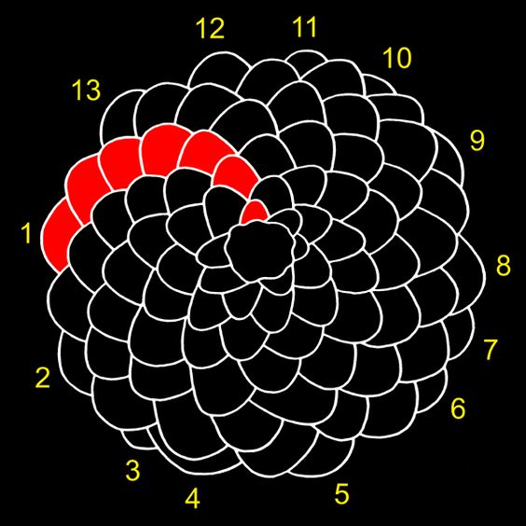
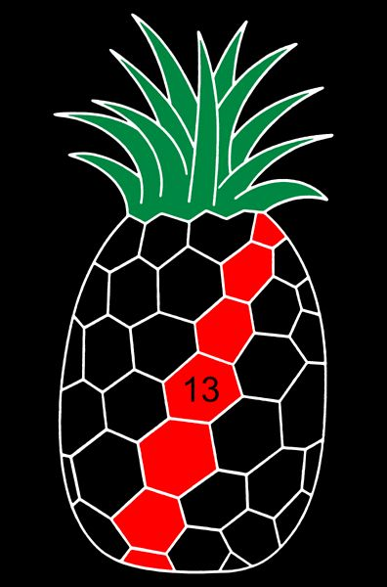
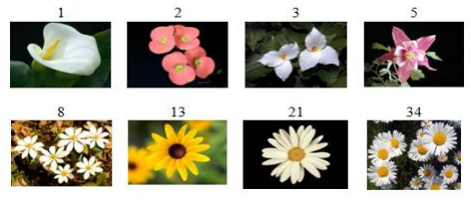
Assumptions on Rabbits
1. Optimal conditions for the two newborn rabbits.
2. Bunny/kittens will not reproduce for 1st month.
3. Then every month female will give birth to a pair.
4. Finally, this will never end :)
Sunflowers seeds
Pine cone
Pine apple
Flower Petals
Picture Sources:
Pine http://www.bomsr.com/4.S1.16/F5%2026-35.pdf
https://curiosamathematica.tumblr.com/post/89242983089/the-life-and-numbers-of-fibonacci
https://staceythinx.tumblr.com/post/24069324443/the-fibonacci-sequence-as-seen-in
https://www.pinterest.ca/pin/49961877085848810/
https://www.pinterest.co.uk/pin/4644405842115329/ apple

Slide 3
Why is the golden ratio equal to 1.618?

Slide 4
Findings
Let's choose any 2 numbers, A and B, as the first 2 terms. Then, if we make a sequence where each number is made by adding the previous 2 numbers:
This new sequence will be the sum of 2 Fibonacci sequences with different weights and delays.
New Sequence = A*F(n-2) + B*F(n-1).
--
Finally, I thank you for watching this video. If you have any questions, please leave them in the comments below.
Also, if you have any video requests or topics of interest, please let me know.
If you like this video, please give it a thumbs up and share it with your friends. Don’t forget to subscribe if you already haven’t. Also, please click on the bell button for channel updates.
Do the first 2 terms need to be 1 always?
What if it is not 1?

